Slide 1


Slide 2
AGENDA:
MDM HUB PROCESS
BATCH VIEWER
BATCH GROUP
EXECUTING BATCH JOB and BATCH GROUP
AUTOMATING & SCHEDULING BATCH GROUP

Slide 3
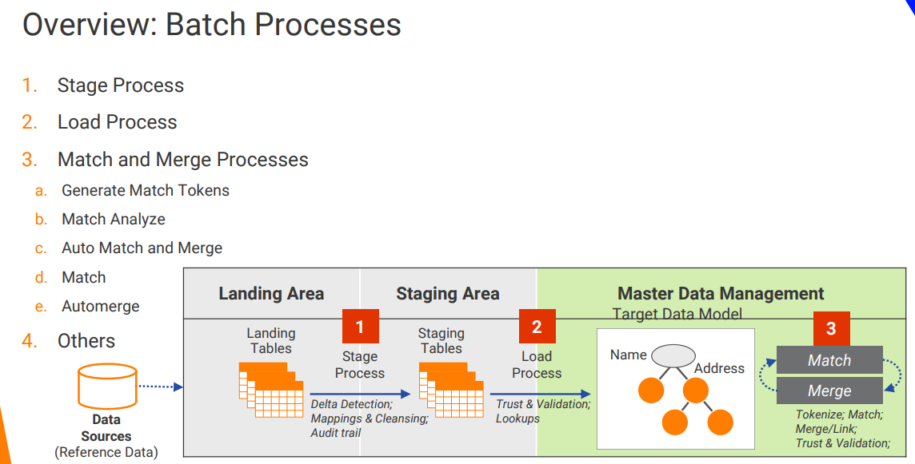

Slide 4


Slide 5
Batch Viewer

Slide 6
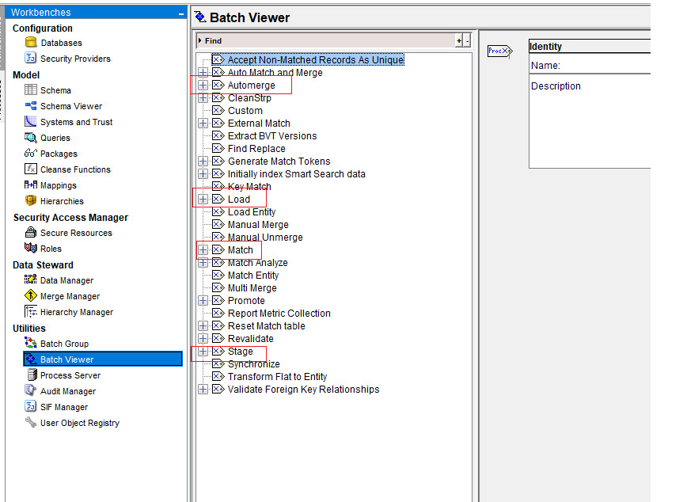

Slide 7


Slide 8


Slide 9
Batch Group

Slide 10
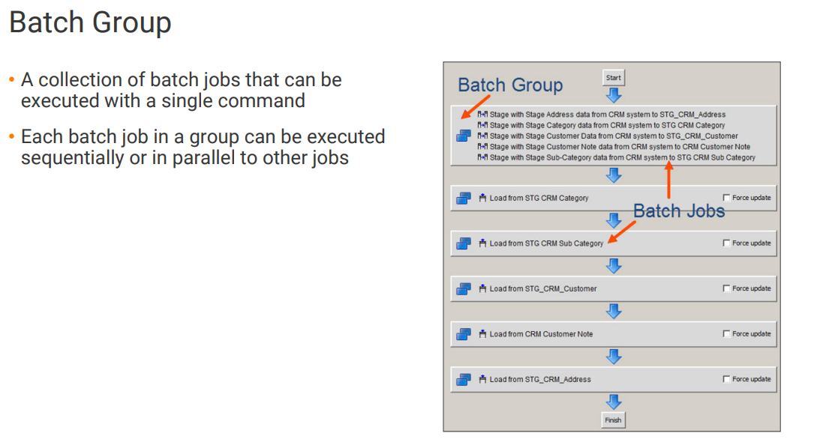

Slide 11
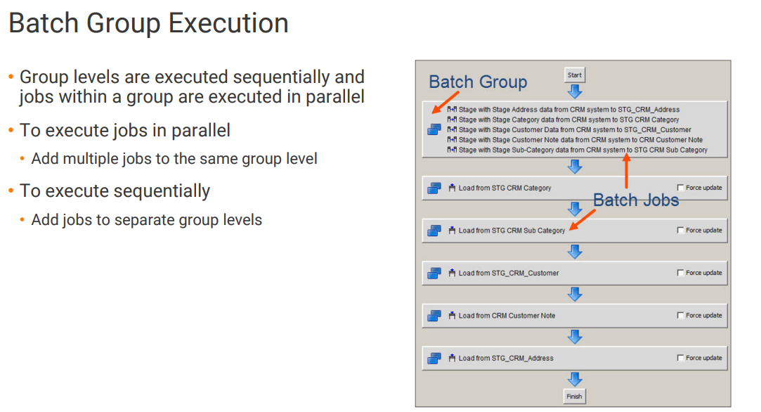

Slide 12
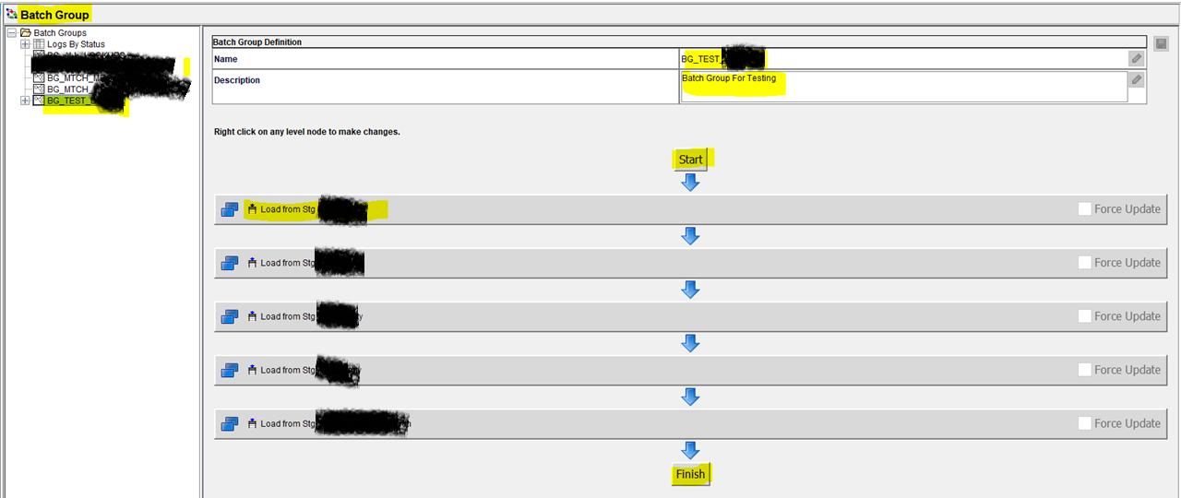

Slide 13


Slide 14
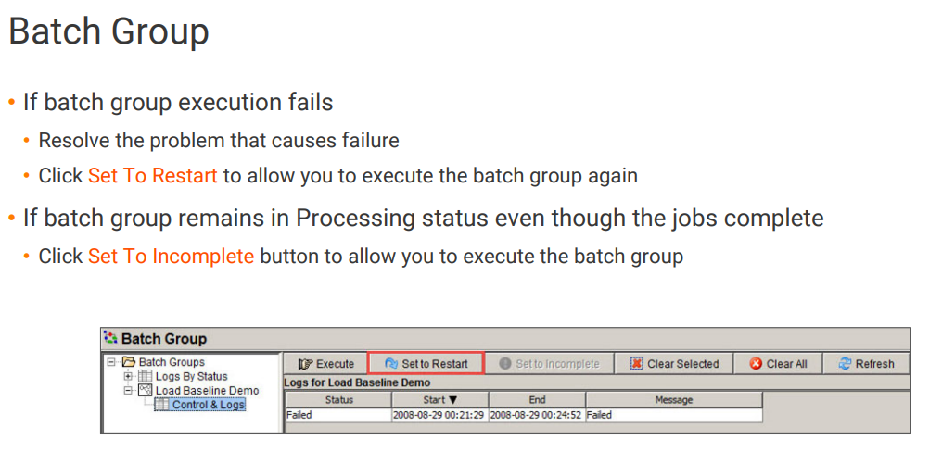

Slide 15
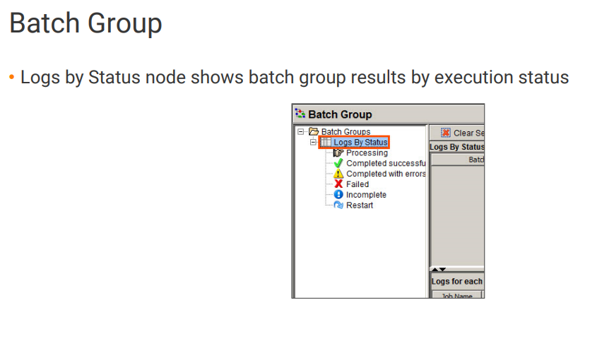

Slide 16
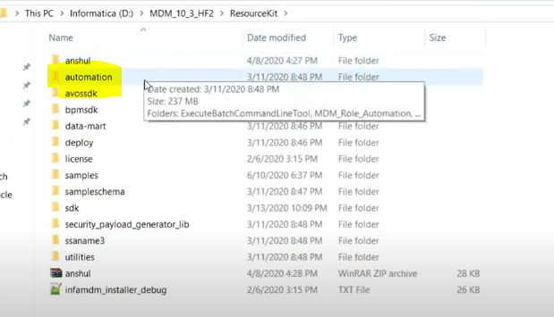


Slide 17



